Slide 1
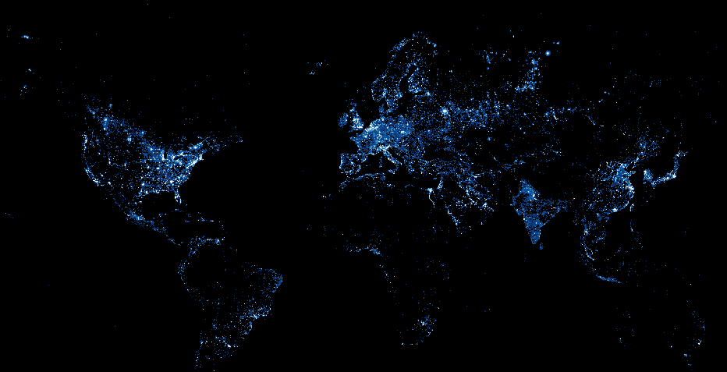
Revealing Economic Growth Using Satellite Night Imagery
Peter Rasmussen
Notes:
Having worked in multiple Sub-Saharan African countries,
I can attest to fact that socioeconomic data that is readily available for communities in the US – that we take for granted - is often not there in emerging markets
This is because traditional means of getting socioeconomic data can be imprecise or unavailable
For certain countries, it can be difficult to get country-level data, let alone subnational data at the city and provincial levels
And getting good data is important
For instance, GDP data is valuable to governments to make policy, investors and consultancies are interested in sizing a given market, local companies, and the aid agencies use the information to develop better programs
Currently, a lot of this information is simply unavailable

Slide 2
Issue: Data gaps in emerging markets
GDP
Syria
Afghanistan
Notes:
So let’s see an illustration of this issue using GDP data for three conflict and post-conflict countries

Slide 3
Issue: Data gaps in emerging markets
GDP
Syria
Afghanistan

Slide 4
Issue: Data gaps in emerging markets
How do we measure economic growth in places where statistics are imprecise or unavailable?

Slide 5
Hypothesis
We can use satellite night light imagery to measure GDP
Notes:
During times when economic data couldn’t be collected, the satellites were collecting imagery data from above
We can use that historical data to fill in the gaps for gdp data
We can also use current data to estimate gdp of cities in emerging markets, data which isn’t readily available

Slide 6
Methodology
Data
Analysis
250+ country-level regressions
400+ city GDP estimates
Comparison to other datasets
Notes:
Data from NOAA: 1992 to 2013
GDP data from World Bank
250 country-level linear regressions to model how light intensity correlates with given country’s GDP
Then, I conducted the analysis for cities with populations greater than 1 million (as of 2009) to measure GDP at the local level

Slide 7
Results: Country-Level Regressions
r²
0.12
0.92

Slide 8
Results: Country-Level Regressions
Emerging markets tend to correlate to light better than developed / industrialized markets
Notes:
Correlation for developed / industrialized countries may be poorer because they are already electrified

Slide 9
Results: Syria Case Study
Notes:
Here we see intertemporal night light data for Syria, Afghanistan, and Somalia
We can use this information to fill in the gaps in GDP data

Slide 10
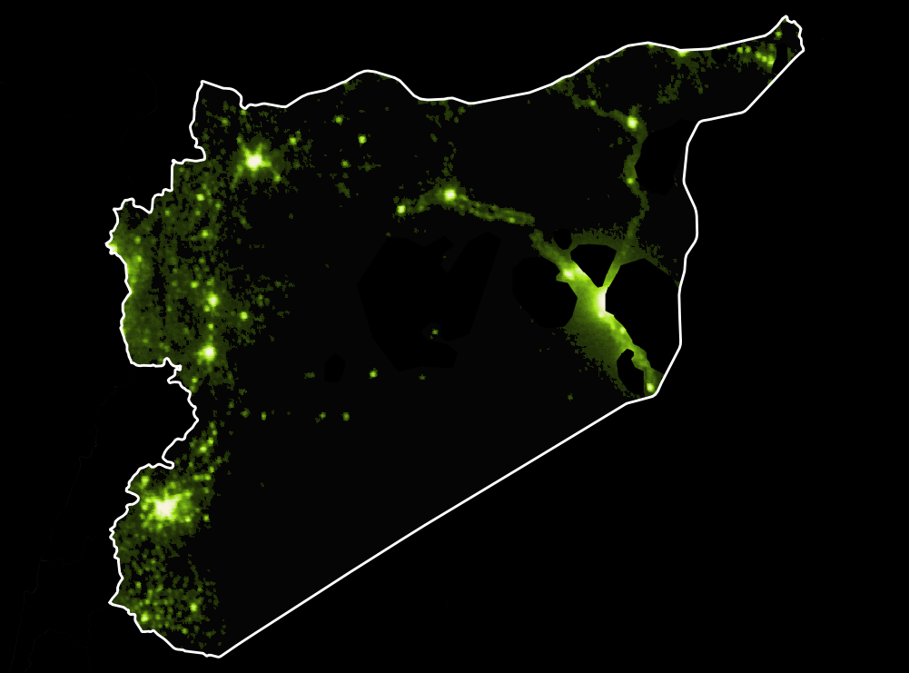
1992

Slide 11
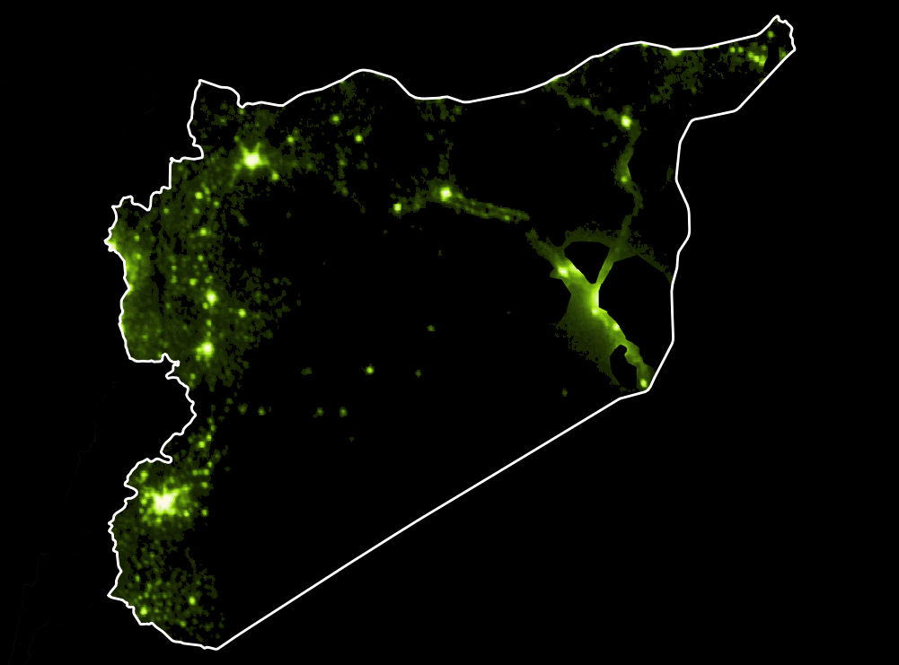
1993

Slide 12
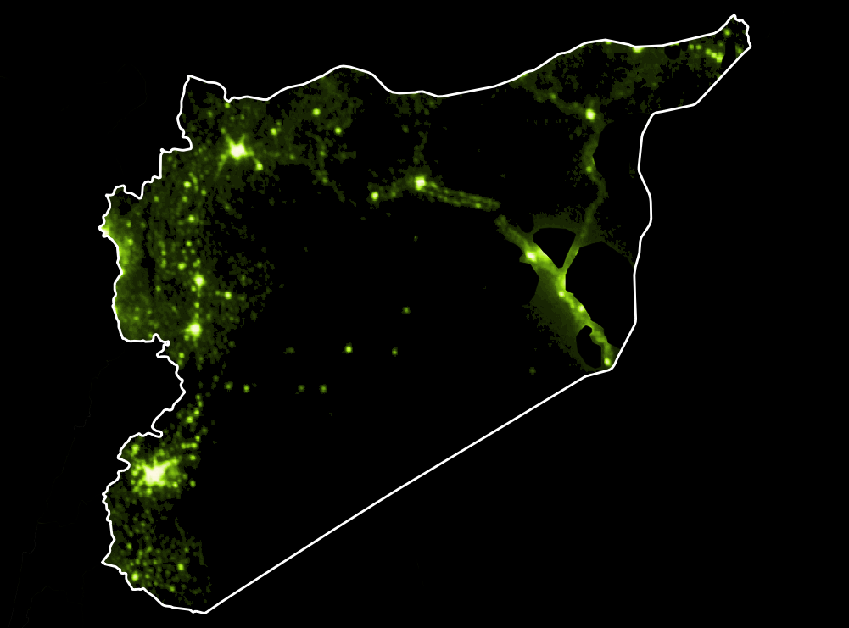
1994

Slide 13
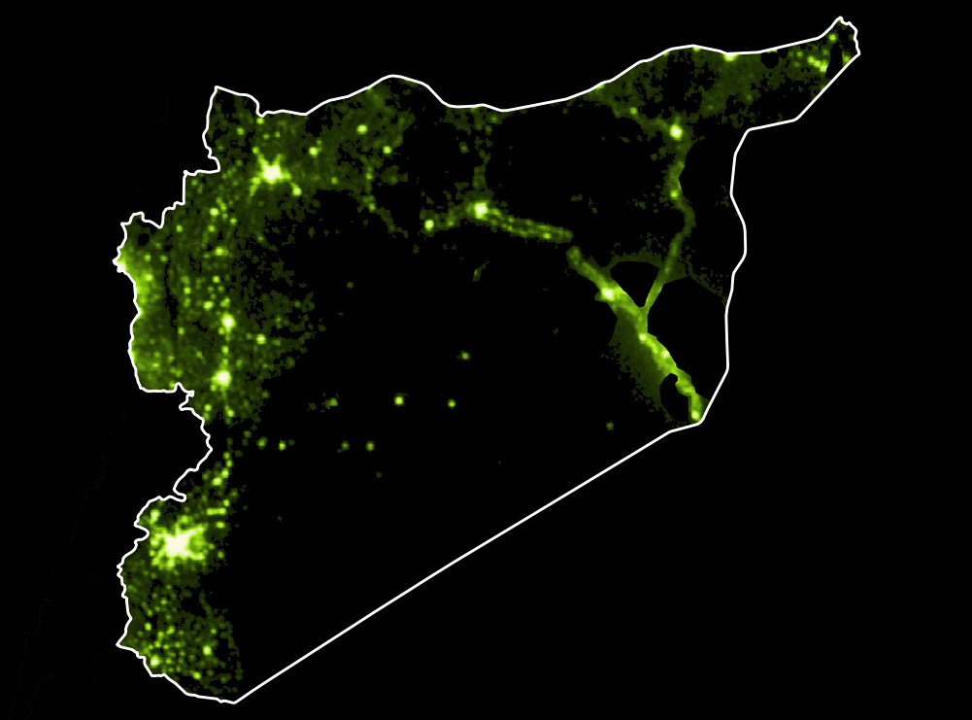
1995

Slide 14

1996

Slide 15
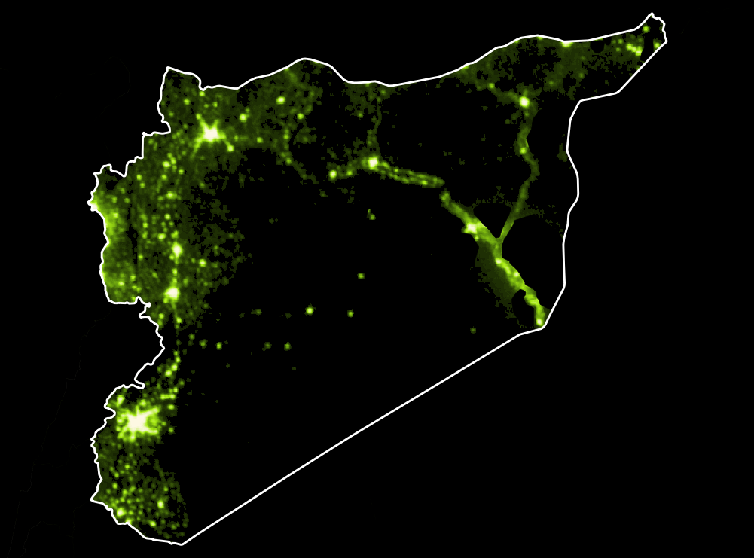
1997

Slide 16
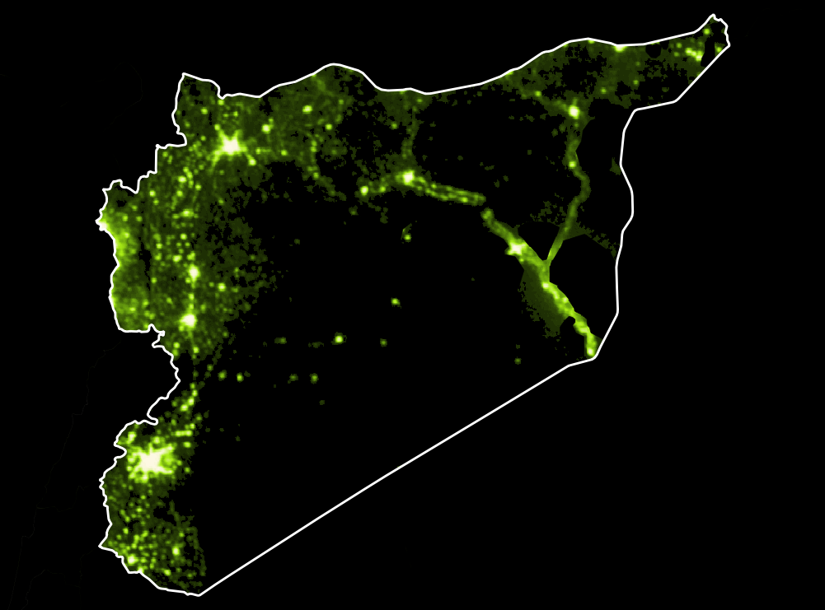
1998

Slide 17
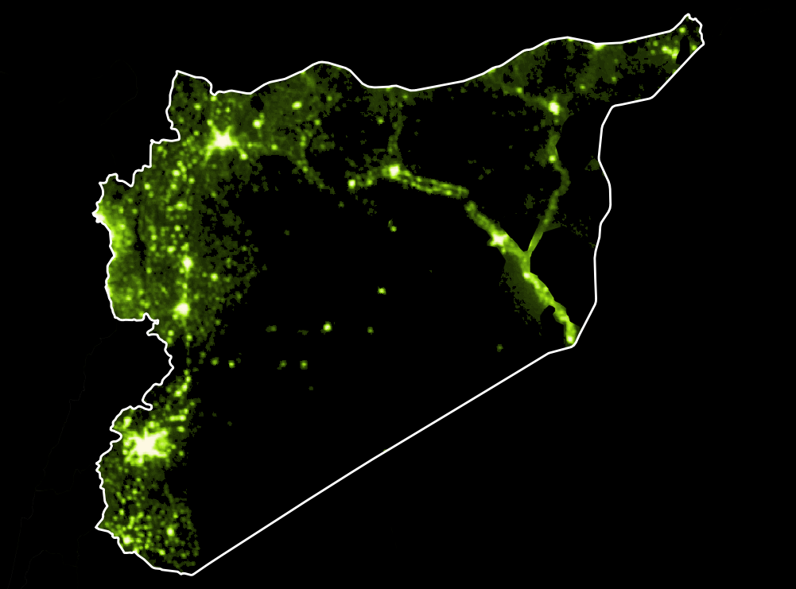
1999

Slide 18

2000

Slide 19
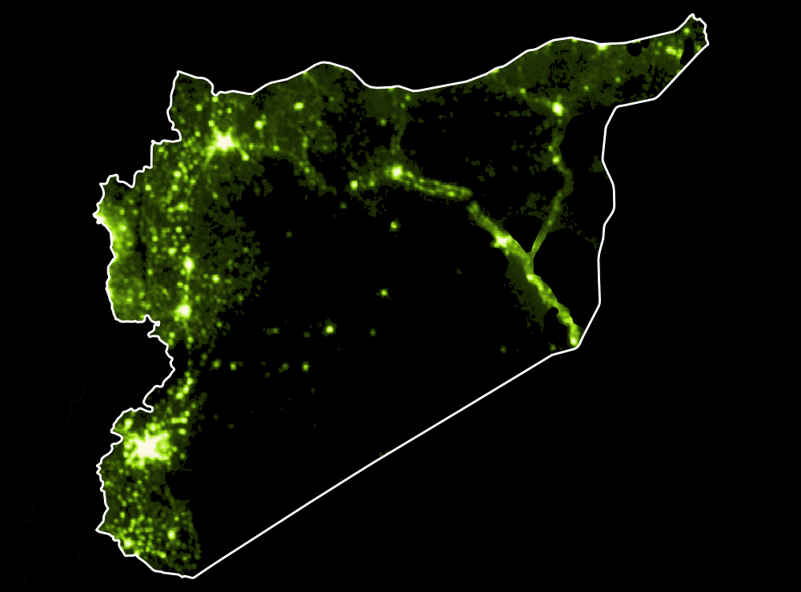
2001

Slide 20

2002

Slide 21
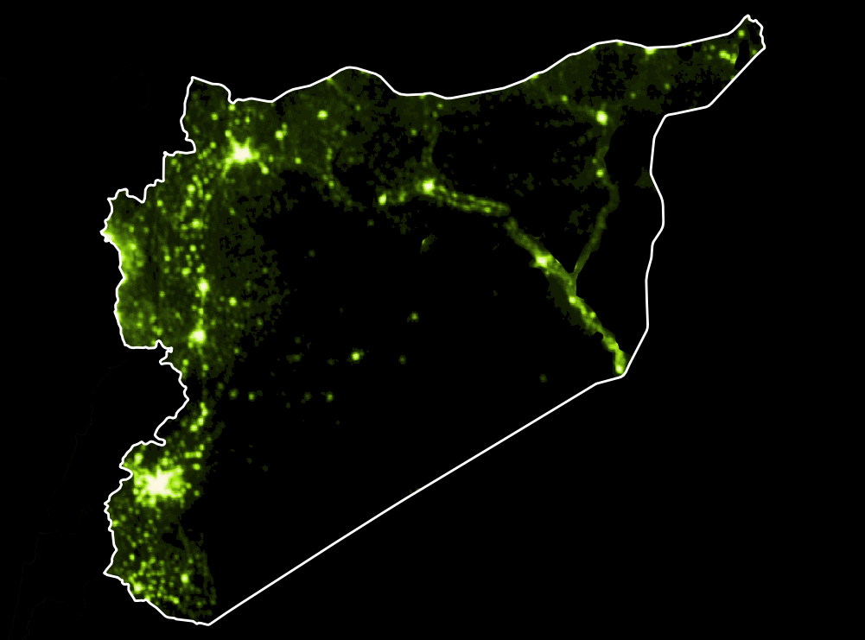
2003

Slide 22
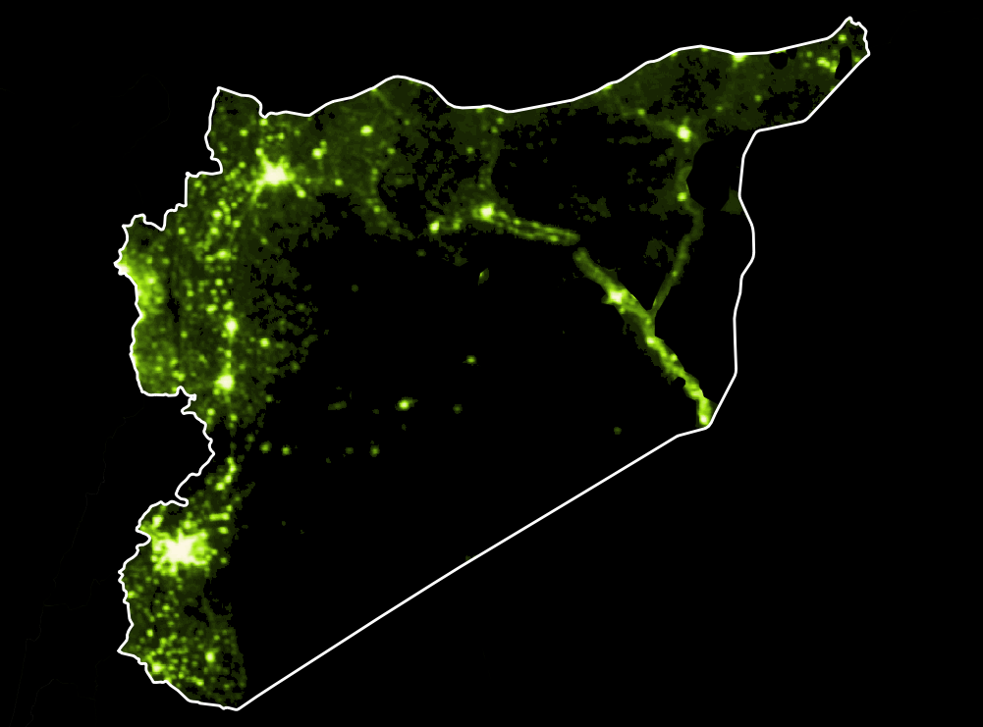
2004

Slide 23

2005

Slide 24

2006

Slide 25

2007

Slide 26

2008

Slide 27

2009

Slide 28
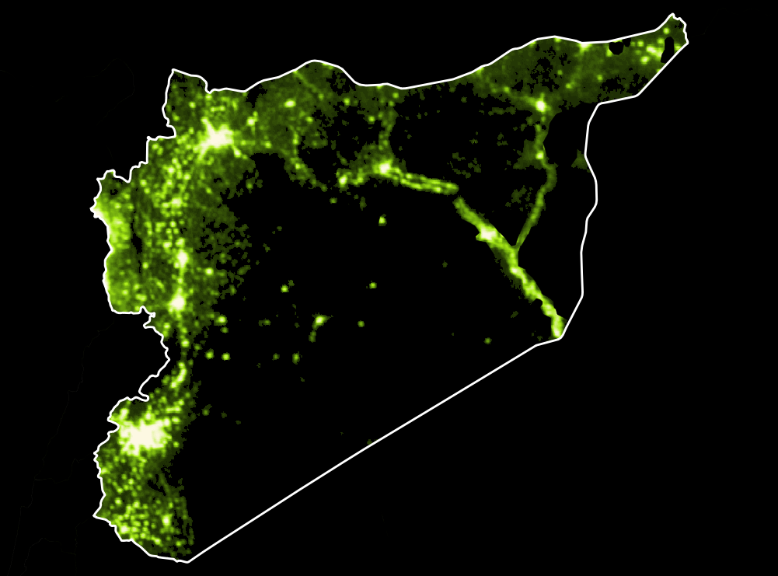
2010

Slide 29
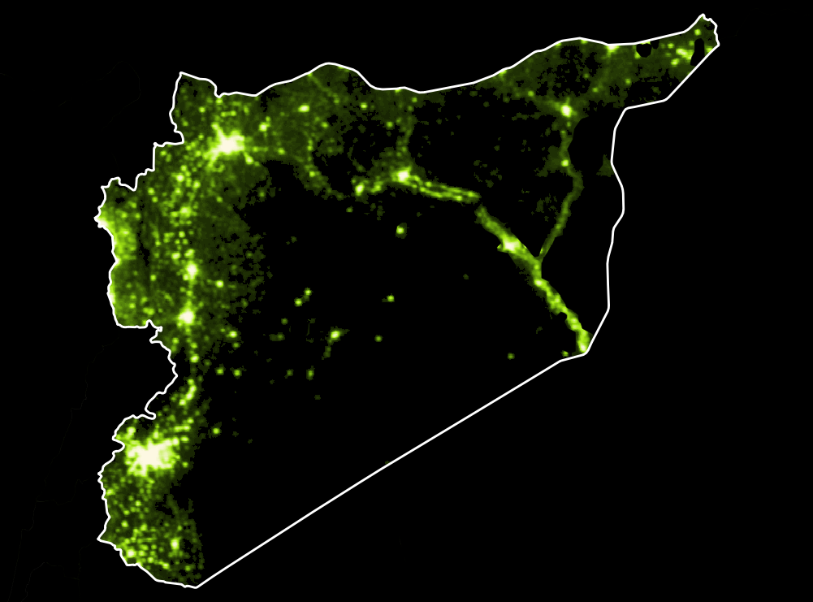
Civil War
2011

Slide 30

Civil War
2012

Slide 31
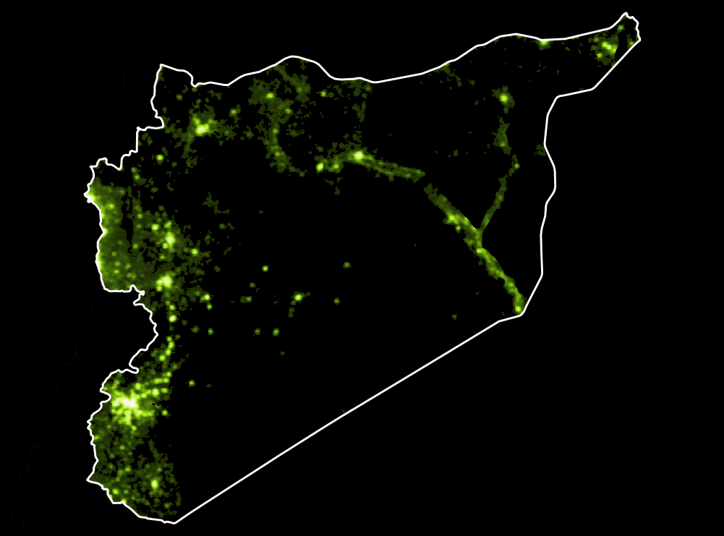
Civil War
2013

Slide 32
Issue: Data gaps in emerging markets
GDP
Syria
Afghanistan

Slide 33
Results: City-Level GDP Est v PwC

Slide 34
Results: City-Level GDP Est v PwC
Notes:
Going forward, we can use night light and other remote sensing imagery as proxies to measure historical and current economic activities
The possibilities are

Slide 35
Thank You!
Blog
pgr-me.github.io
peter.gray.rasmussen@gmail.com
pgr-me
petergrayrasmussen

